Slide 1

Text Editor in C
24BCA10387
24BCA1005

Slide 2

Introduction
A simple text editor program written in C.
Allows users to:
Add new lines of text.
Delete the last added line.
Display all stored lines.
Exit the program.
Designed for learning basic text manipulation and user interaction in C.

Slide 3
Program Features
Add Line:
Adds a new line of text to the buffer.
Delete Last Line:
Removes the most recent line added.
Display Text:
Displays all stored lines in the text buffer.
Exit:
Exits the text editor gracefully.

Slide 4

Code Overview
The program uses simple functions to handle text operations:
addLine(): Adds a new line to the buffer.
deleteLine(): Deletes the last line.
displayText(): Displays all lines in the buffer.
main(): Provides the user interface and handles user input.

Slide 5
Code Snippet: Add Line Function
// Function to add a line
void addLine(const char *line) {
if (lineCount >= MAX_LINES) {
printf("Text buffer is full! Cannot add more lines.\n");
return;
}
strncpy(text[lineCount], line, MAX_LENGTH - 1);
text[lineCount][MAX_LENGTH - 1] = '\0'; // Ensure null-termination
lineCount++;
printf("Line added.\n");
}
Explanation:
Checks if the buffer is full (lineCount >= MAX_LINES).
Copies the input line into the buffer while ensuring it is null-terminated.
Increments the lineCount to track the number of lines added.

Slide 6
Program Flow
Start:
Program shows a menu with options to add, delete, display, or exit.
Menu Options:
User selects an option by entering a choice.
User Interaction:
Add, delete, or display lines based on the choice.
Exit:
User exits the program gracefully when they choose "Exit."

Slide 7
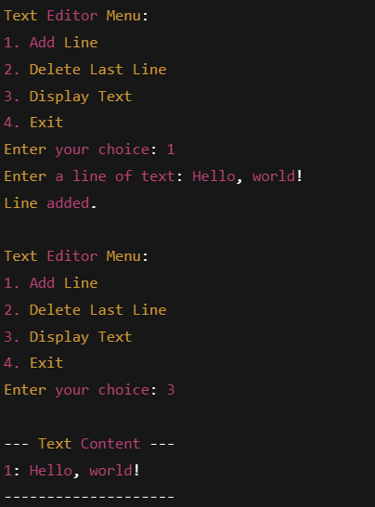
Example Output

Slide 8
Limitations
The program can store up to MAX_LINES lines (default: 100).
Each line is limited to MAX_LENGTH characters (default: 256 characters).
No functionality for editing existing lines.
Limited error handling (e.g., input validation).

Slide 9
Future Improvements
Line Editing:
Allow users to modify an existing line.
File Operations:
Implement saving and loading from files.
Enhanced Error Handling:
Add input validation and better error messages.
Graphical User Interface (GUI):
Transition from CLI to a GUI application for easier interaction.

Slide 10
Conclusion
The program demonstrates basic text manipulation in C.
A useful starting point for learning C programming, especially working with arrays and user input.
Future improvements can expand the program’s functionality and usability.

